Slide 1
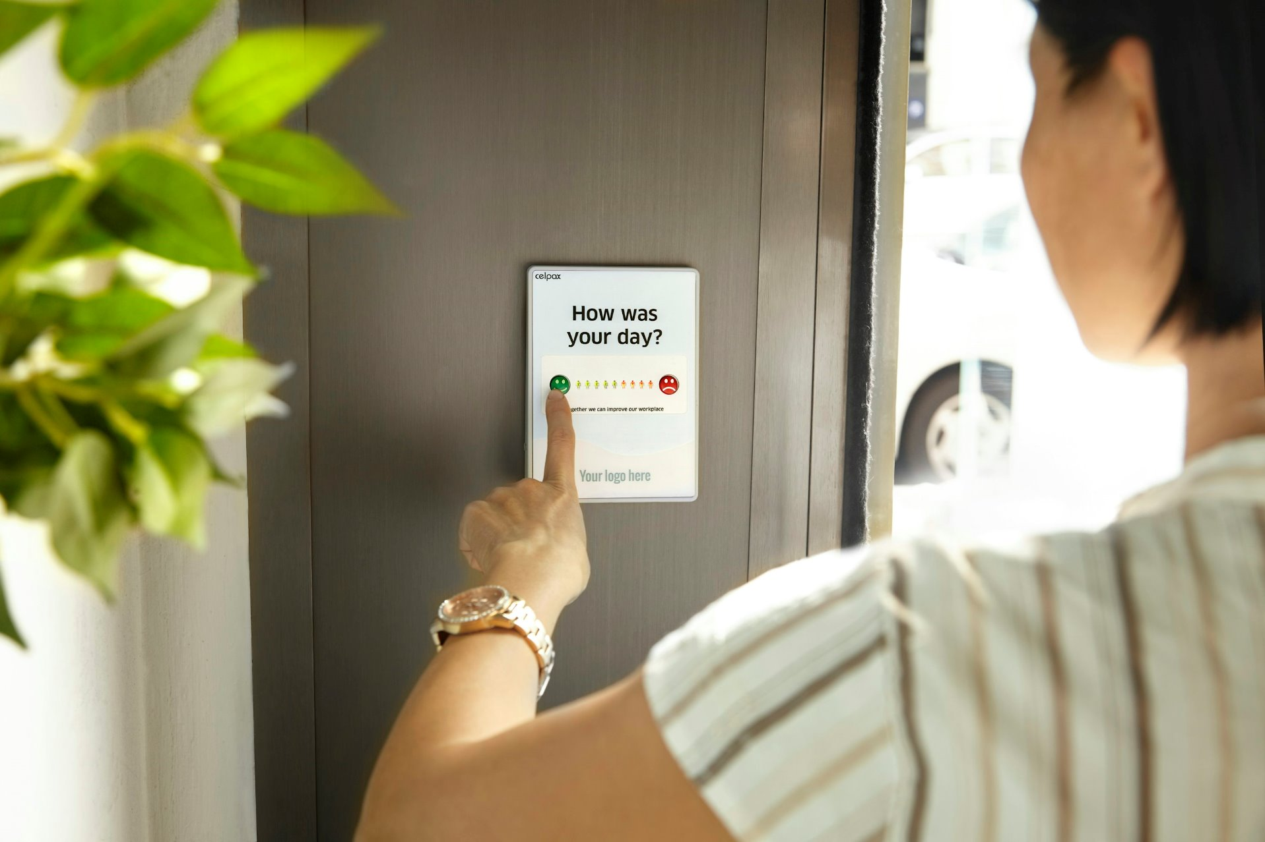


CLINIC TRENDS.AI
A deep dive on customer feedback using most advanced Machine Learning Pipelines

Slide 2


PROBLEM STATEMENT
Many business struggle with turning raw customer feedback into actionable insights.
Traditional surveys are manual, disconnected and hard to analyze, which leads to missed opportunities for service improvement.

Slide 3
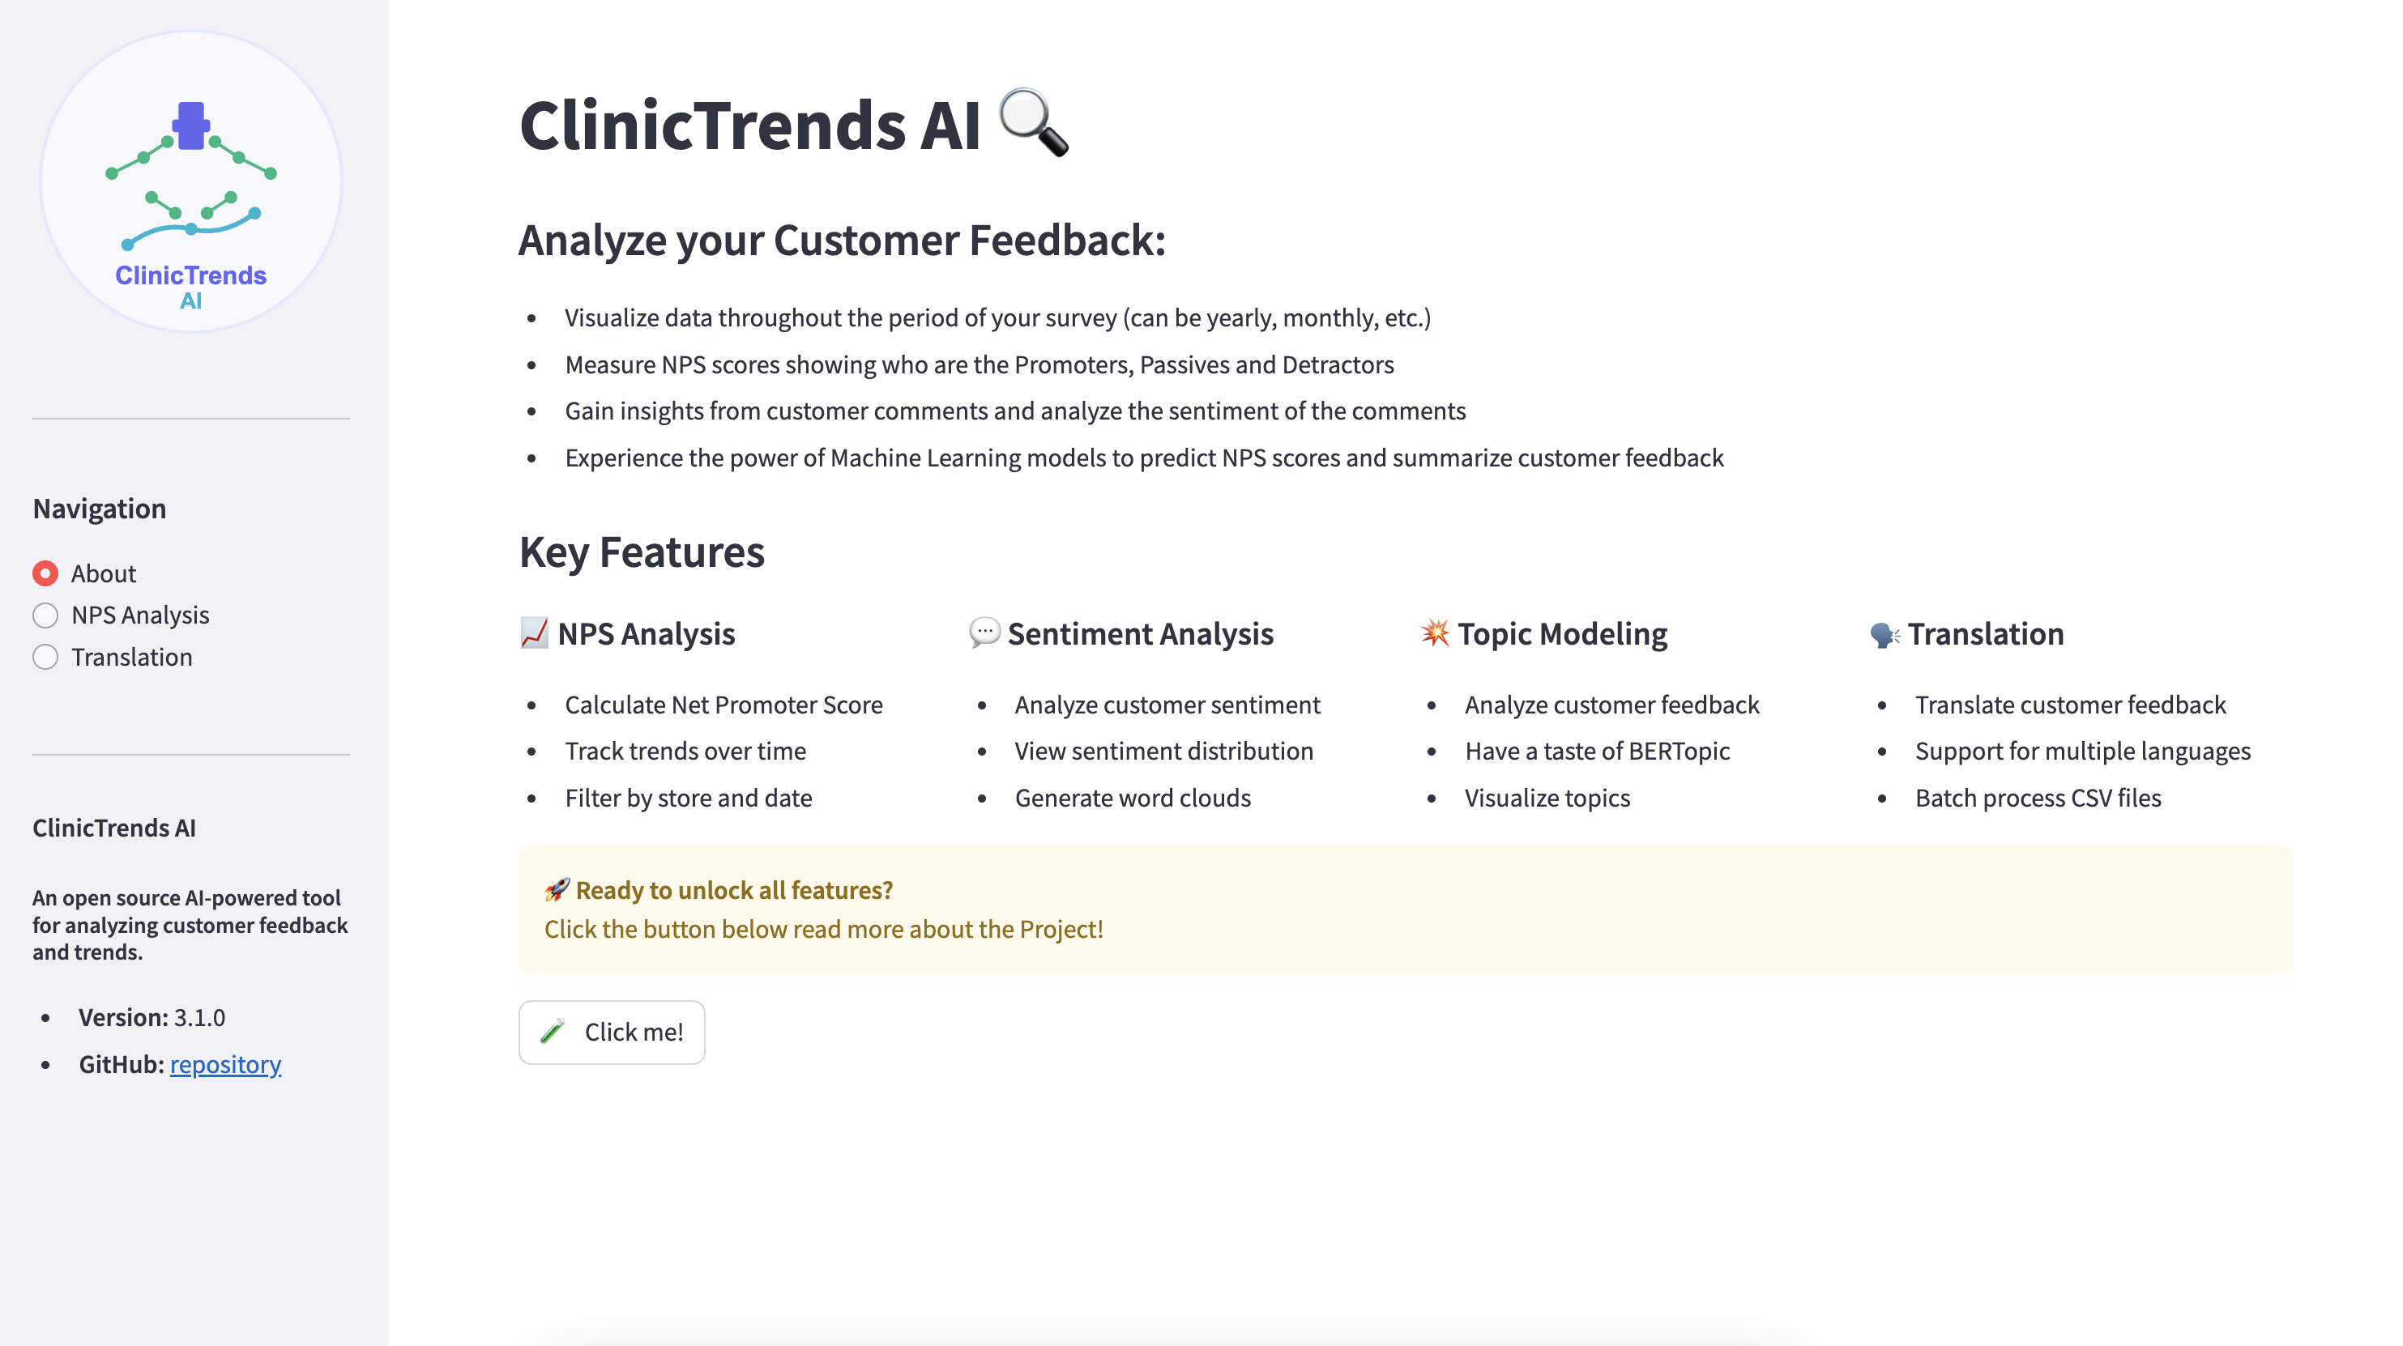
PROPOSED SOLUTION
ClinicTrends AI is our answer!
Smart analytics dashboard that analyzes and visualizes
customer sentiment + NPS data through NLP techniques + AI

Slide 4
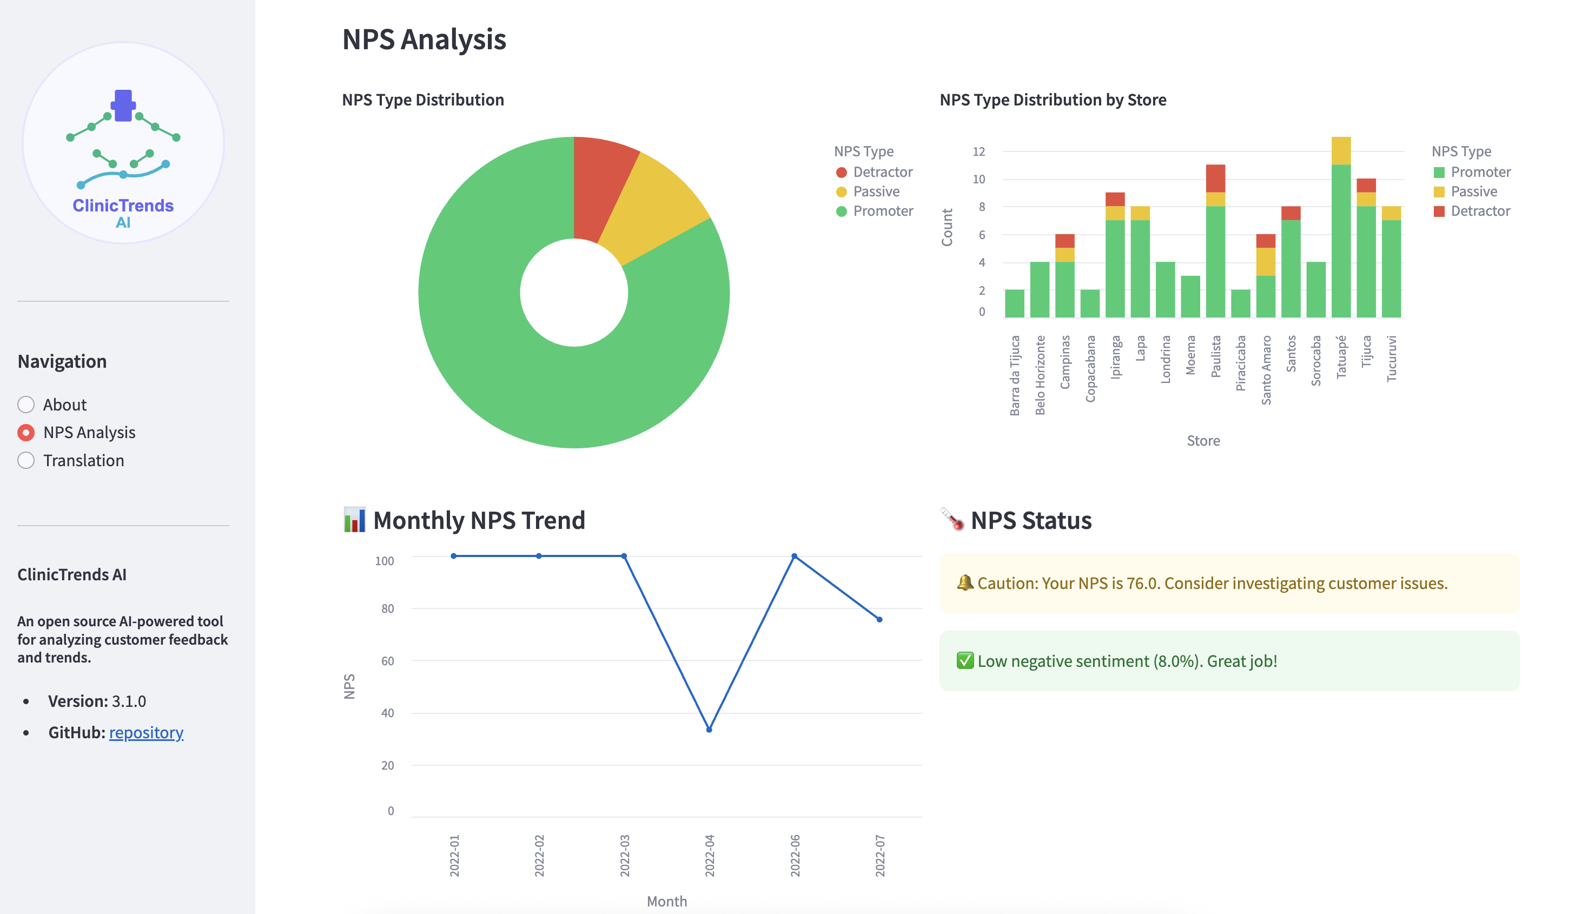
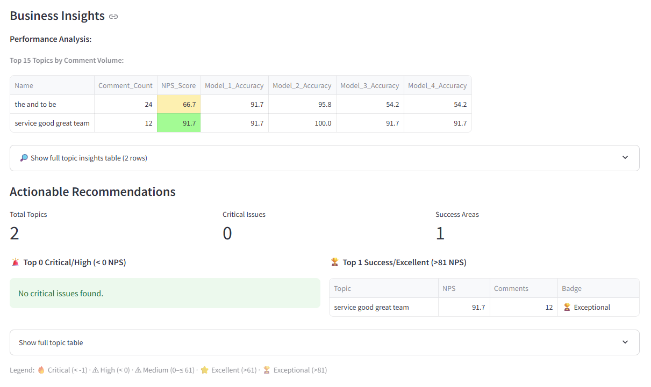
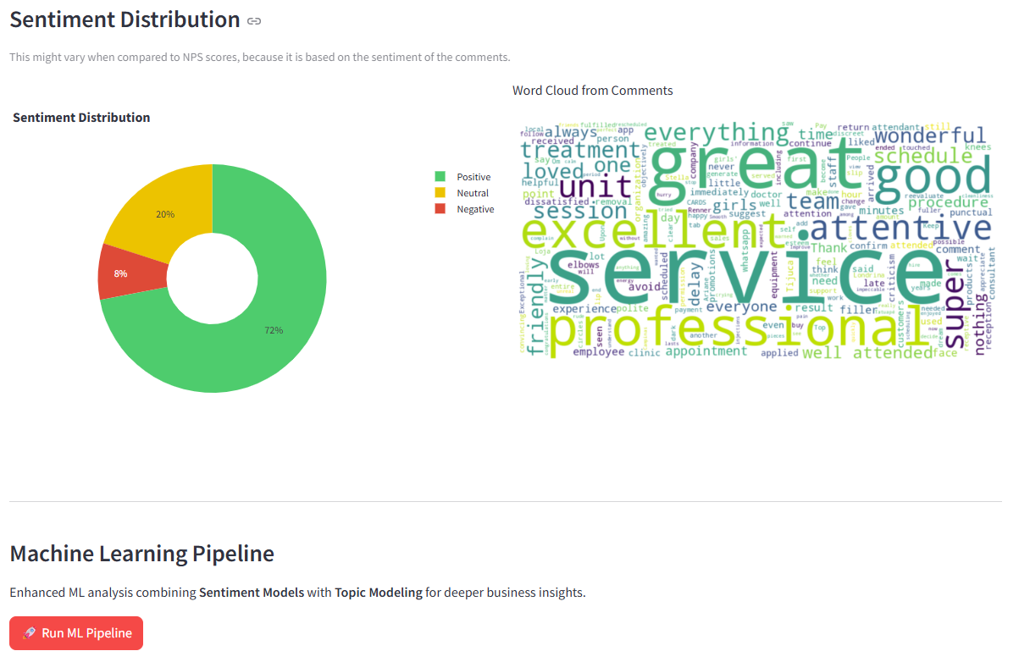
KEY FEATURES
CSV upload and export
NPS scoring:
Alert generation reporting
Sentiment analysis
Machine Learning Pipeline:
4 custom models
Topic Modeling
Business Insights

Slide 5
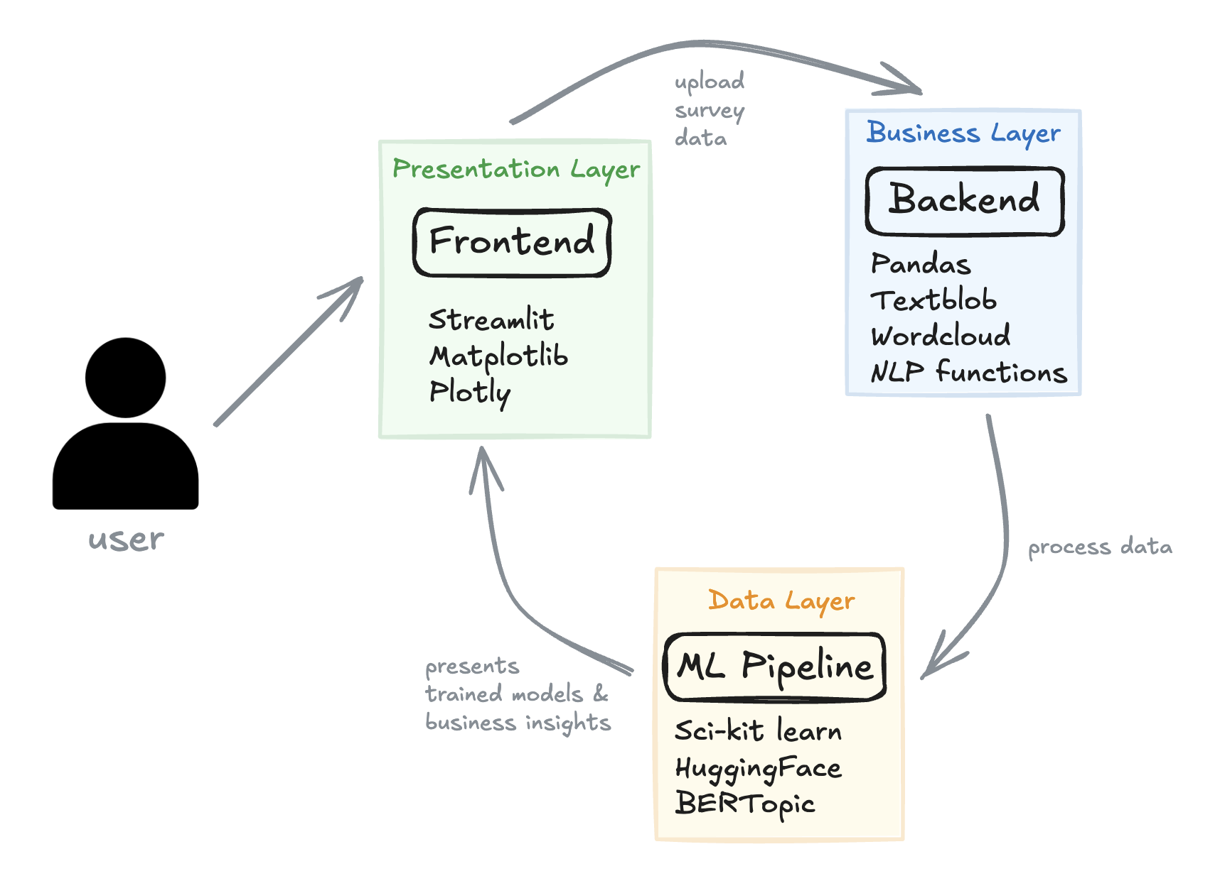
SYSTEM ARCHITECTURE
The app combines several modules:
Frontend built with Streamlit
Preprocessing engine using pandas
ML Pipeline with:
TF-IDF Logistic Regression
HuggingFace Transformers
Topic modeling and insights

Slide 6
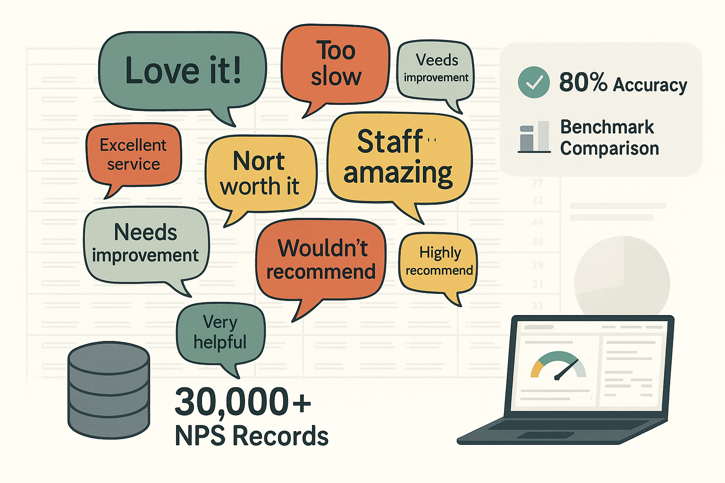
MASSIVE DATA SCALE
People really write their feelings on a web form!
30,000+ NPS records: real customer voices.

Slide 7
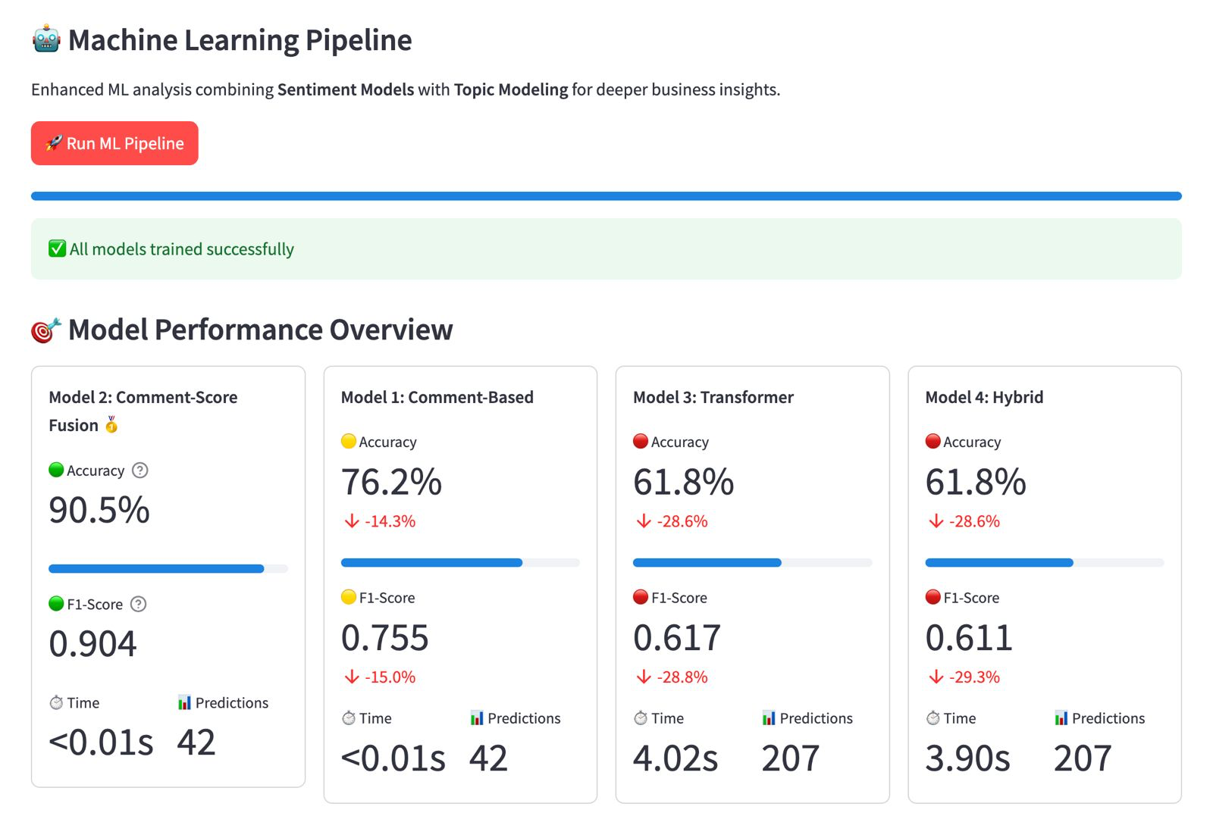
TESTING & VALIDATING
We used sample datasets and unit tests to validate model accuracy, user inputs, and edge cases.

Slide 8


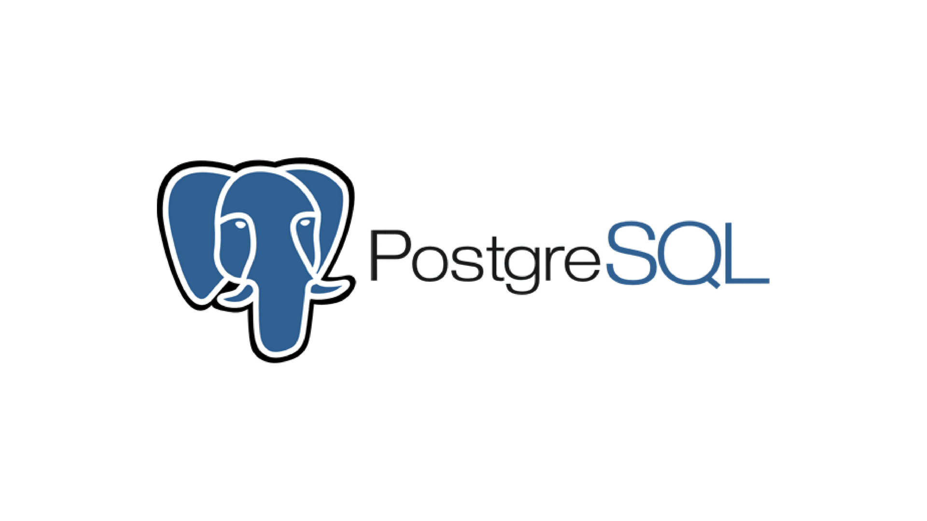
OUTCOMES... FUTURE WORK
v1.0.0
Core Streamlit application architecture
Multi-page navigation system
Translation capabilities via Deep-translator
Sentiment Analysis using TextBlob + wordcloud generation
4 Machine Learning model implementations
Pytest setup
v2.0.0
A/B testing framework for model comparison
Model fine-tuning and reaching accuracy of +80%
Automated hyperparameter optimization
Implemented Topic Modeling with BERTopic
v3.0.0
v4.0.0
Real-time model retraining capabilities
RESTful API development
Database integration
User authentication & role-based access
Advanced security & compliance features
Automate pipeline input
GPT-powered natural language insights
Automated report generation
Predictive customer lifetime value modeling
Integration with CRM systems
Pytest Coverage
Advanced feature engineering pipelines
Machine Learning Pipeline (4 models) to NPS Page
Topic Modeling to Machine Learning Pipeline
Streamlit
Setup
Intelligent
Enhancement
Machine Learning
Pipeline
Enterprise
Integration
AI-Powered
Insights
v5.0.0

Slide 9
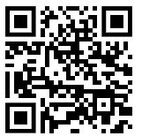
DEMO INSTRUCTIONS
To test the tool, simply upload a CSV with customer comments and scores.
The app will process the data, present a graphics and allow you to run ML pipelines.
https://sep-torrens-dr-ranju-group-1.streamlit.app/
SCAN TO ACCESS DEMO!

Slide 10

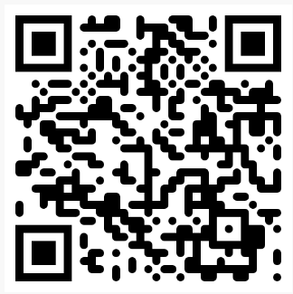




THANK YOU!
Shout out to the Open-Source Community!
ClinicTrends AI is built on top of these awesome libraries:
SCAN TO SHARE YOUR THOUGHTS!

